Slide 1

Low Precision Computation on Neural Networks (Week 11)
May 26, 2020
Sungjoo Yoo
Computing Memory Architecture Lab.
CSE, SNU
http://cmalab.snu.ac.kr

Slide 2
Weekly Schedule
W1 17 Application (deep learning on FPGA)/SW app (MNIST/CIFAR)
W2 25 Verilog 1 Basics/Vivado tutorial (verification level of HW design)
W3 31 Verilog 2 Combinational circuits (Video pre-view homework + TA Q&A)/Simple adder using dsp (V+V, Verilog intro)
W4 4/7 Verilog 3 Sequential circuits/V*V processing element (PE) design 1
W5 14 Verilog 4 Design example & synthesizable code/V*V processing element (PE) design 2
W6 21 Convolution lowering and matrix multiplication accelerator/Convolution lowering (V0)
W7 28 Intro to Zynq & MV accelerator design/Zynq FPGA & synthesis, continue VV design & start MV accelerator design
W8 5/5 (Children’s day) Optional lab session is provided in lecture and lab hour
W9 12 Main memory (physical & virtual)/OS+FPGA (HOST~DEVICE) communication & MV design 2
W10 19 Bus and DMA (Video pre-view + TA Q&A)/custom IP & MV design 3
W11 26 Advanced deep learning #1 quantization for low precision computation/V0+DMA+8b
W12 6/2 Advanced deep learning #2 zero skipping/V0+DMA+8b+zero-skipping 1
W13 9 Final exam/V0+DMA+8b+zero-skipping 2
W14 16 Term project (V0+DMA+8b+zero) submission
Notes:
From this we will start to work on the baseline MV accelerator.

Slide 3
Notice
Final exam is scheduled on June 9th
Previous mid/final exams will be provided at eTL by June 2nd

Slide 4
Agenda
Lecture
Quantization for low precision computation on neural networks
Introduction to the lab on Week 11
MV accelerator for 8-bit quantization

Slide 5
Introduction
What is quantization?
Reducing bit width of weight and activation (=feature map data), e.g., from 16-bit to 4-bit
4b
weight
16b
weight
4b
*
4b
4b
*
MUL
ADD
ADD
4b
*
activation
16b
activation
4b
4b
*
4b
Conventional convolution with 16bit data
Convolution with narrow (4bit) data

Slide 6
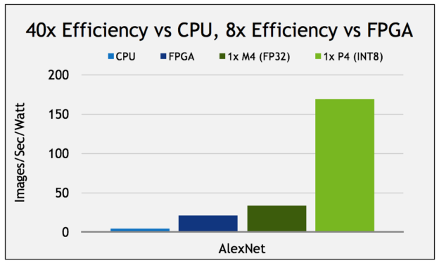
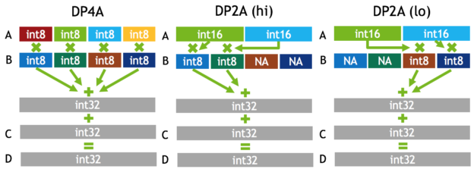
Introduction (Cont’d): Quantization Trend
[https://devblogs.nvidia.com/parallelforall/mixed-precision-programming-cuda-8/]
NVIDIA
P40 and P4 support int8, i.e., 8-bit integer for inference purposes

Slide 7
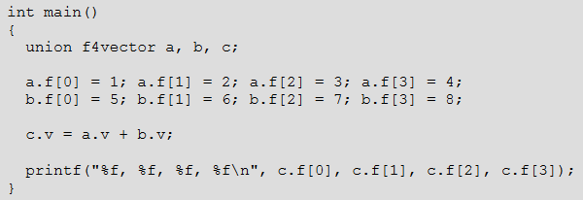
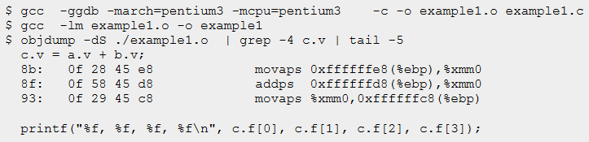
SIMD or Vector (Addition)
vector A
A[0]
A[1]
A[2]
A[3]
vector B
B[0]
B[1]
B[2]
B[3]
+
+
+
+
vector C
C[0]
C[1]
C[2]
C[3]

Slide 8
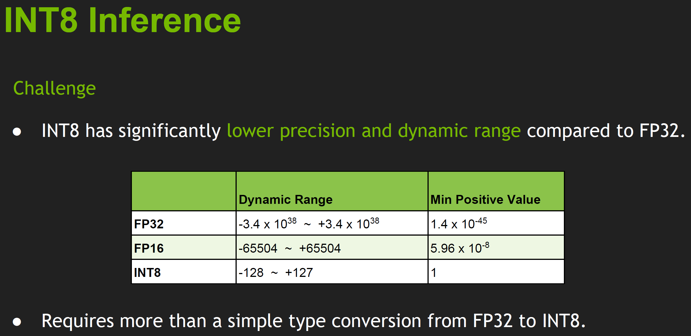
[Migacz, 2017]

Slide 9
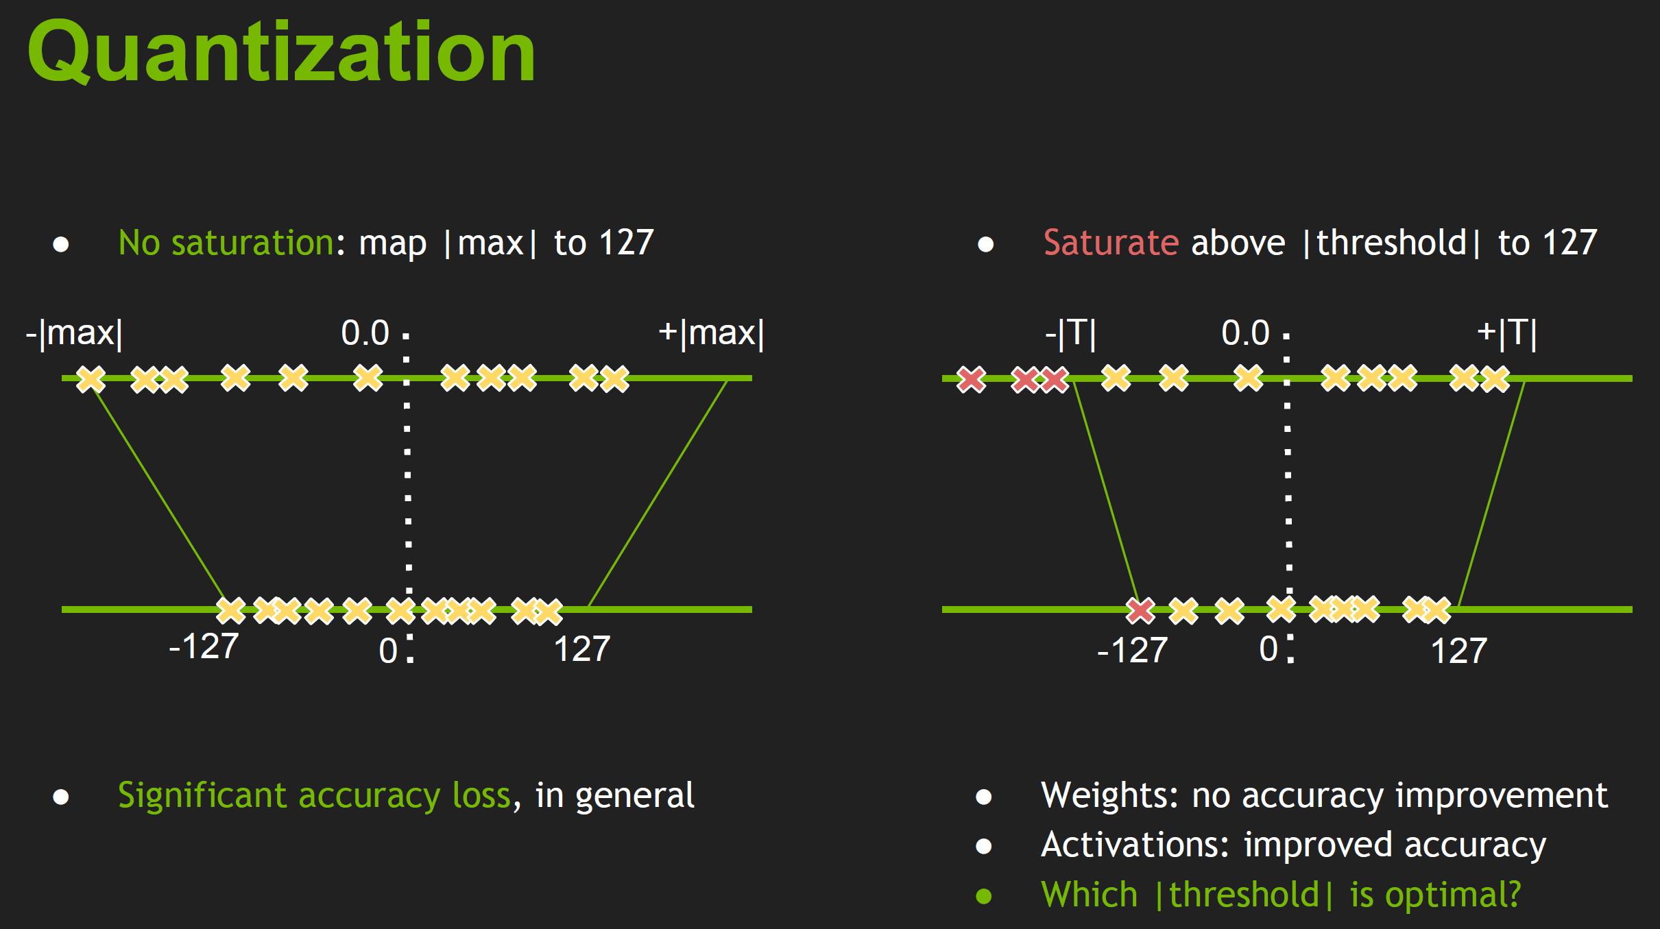

Slide 10
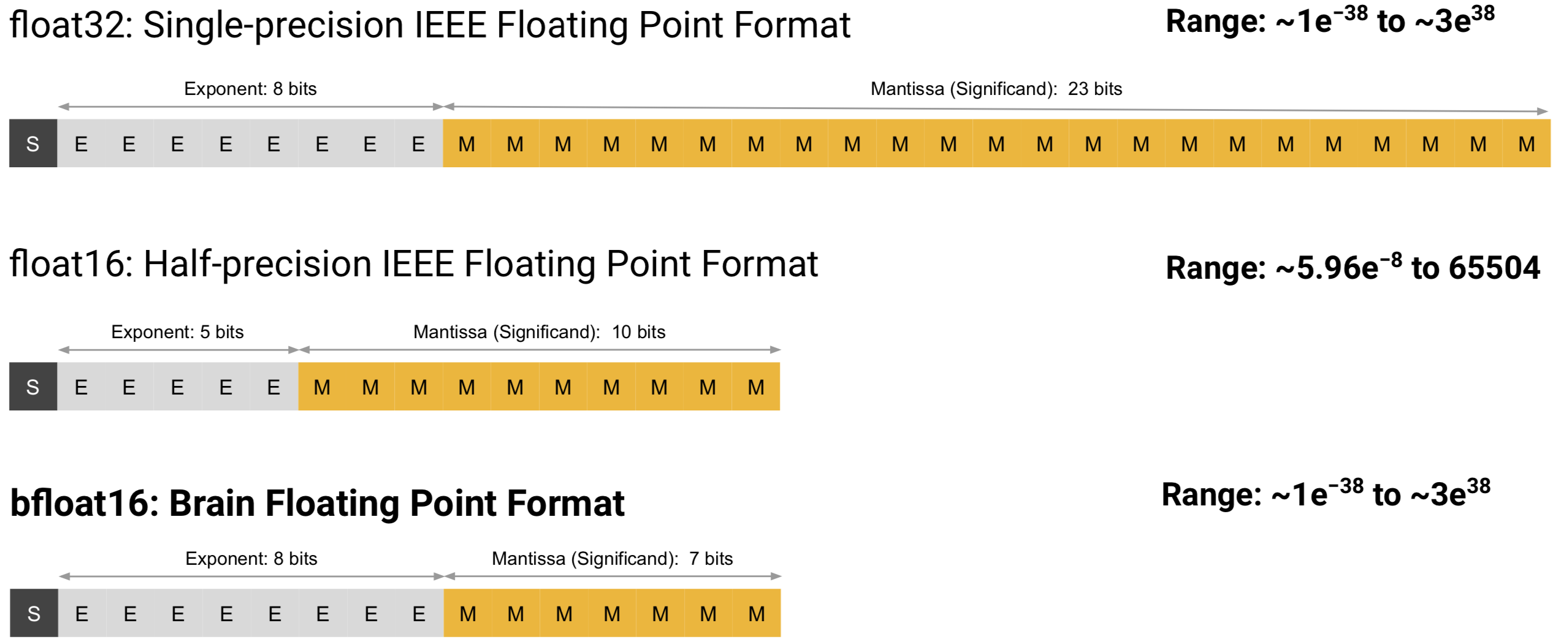
32 and 16 bit Floating Point Representations

Slide 11
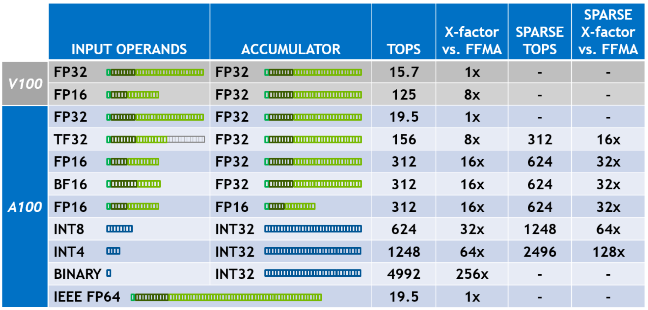
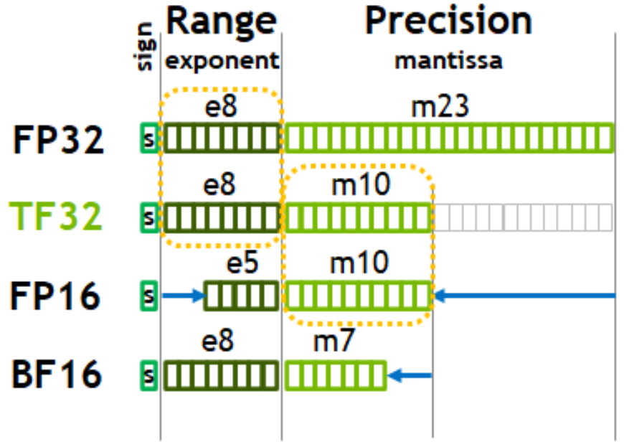
Precision in Nvidia A100
[https://www.nvidia.com/content/dam/en-zz/Solutions/Data-Center/nvidia-ampere-architecture-whitepaper.pdf]

Slide 12
Quantization for Low Precision: Agenda
Google’s int8 quantization
Quantization and Training of Neural Networks for Efficient Integer-Arithmetic-Only Inference, CVPR 2018
NVIDIA’s int8 quantization
8-bit Inference with TensorRT
Logarithm-based quantization
Convolutional Neural Networks using Logarithmic Data Representation, CVPR 2017
Binary-weight neural network
XNOR-Net: ImageNet Classification Using Binary Convolutional Neural Networks

Slide 13
Google’s Int8 Solution
[Jacob, 2018]
Goal: running int8 neural networks on CPUs supporting int8 SIMD instructions
Conversion, i.e., quantization from floating to 8-bit unsigned integer
Real value r
32-bit floating
Quantized value q
8-bit unsigned integer with 256 levels
q = round(r / S) + Z
r = S (q - Z)
-3.14
6.57
0
Z
255

Slide 14
Quantization Example
[Jacob, 2018]
Calculating scale (S) and zero (Z) for int8
Example: 10.5 → round(10.5/0.38)+83=28+83=111
-31.4 → 0 -31.4 = S*(0 – Z) SZ=31.4 Z=round(31.4/0.38)=83
65.7 → 255 65.7 = S*(255 –Z) 65.7+31.4=255S S=97.1/255=0.38
q = round(r / S) + Z
r = S (q - Z)
Real value r
32-bit floating
Quantized value q
8-bit unsigned int
29
-31.4
0
10.5
65.7
0
83
111
255

Slide 15
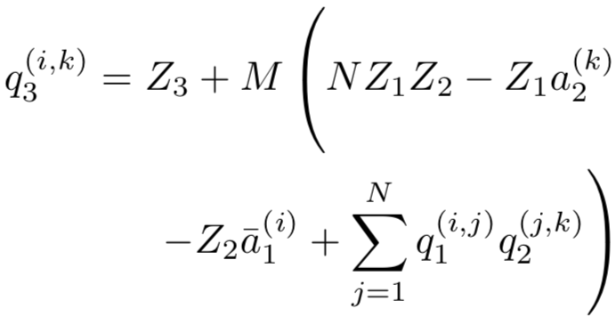
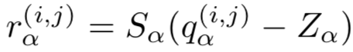
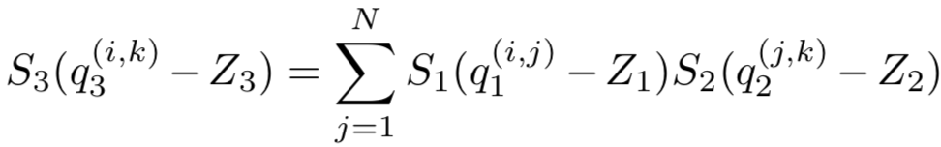
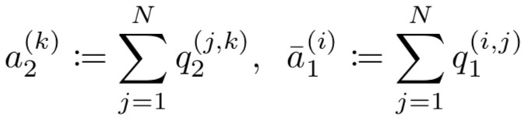
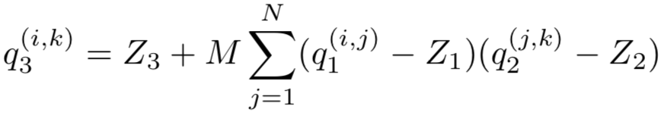
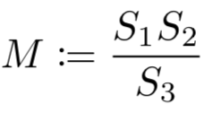
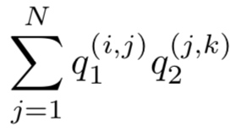
Integer Only Computation
[Jacob, 2018]
Matrix multiplication, r₃ = r₁*r₂
Weight matrix r₁ and activation matrix r₂
What if Z₁ and Z₂ are zero?

Slide 16
Quantization Example: Zero Matching Case as a Trade-off Between Computation Cost and Accuracy
[Jacob, 2018]
Calculating scale (S) and zero (Z) for int8
Example: 10.5 → ceil(10.5 / 0.52)=21
Example: -31.4 → -60
S = max (31.4/127, 65.7/127) = 0.52
Unused value range (& larger scale)
less precision
q = ceil(r / S)
r = Sq
Real value r
32-bit floating
Quantized value q
8-bit unsigned int
Unused
value
21
-31.4
0
10.5
65.7
-127
-60
0
21
127

Slide 17
Quantization Flow
[Jacob, 2018]
Given a trained network, for each layer (separately)
Determine value ranges for weights and activations
Weight: [min,max]
Activation: exponential moving average (EMA) obtained in training
Re-train the network while applying quantization
Forward pass: insert fake quantization while performing floating point (fp) comp.
Fake quantization for weights: before each batch, quantize weights and use them in fp
Fake quantization for activations: quantize layer output at each layer and use them in fp
Backward pass: no change
Insert quantization into the network
Weight: constant integer values
Activation: quantization function, q = ceil(r / S) + Z is inserted into the network to covert layer output r to integer q during runtime

Slide 18
Quantization for Low Precision: Agenda
Google’s int8 quantization
Quantization and Training of Neural Networks for Efficient Integer-Arithmetic-Only Inference, CVPR 2018
NVIDIA’s int8 quantization
8-bit Inference with TensorRT
Logarithm-based quantization
Convolutional Neural Networks using Logarithmic Data Representation, CVPR 2017
Binary-weight neural network
XNOR-Net: ImageNet Classification Using Binary Convolutional Neural Networks

Slide 20
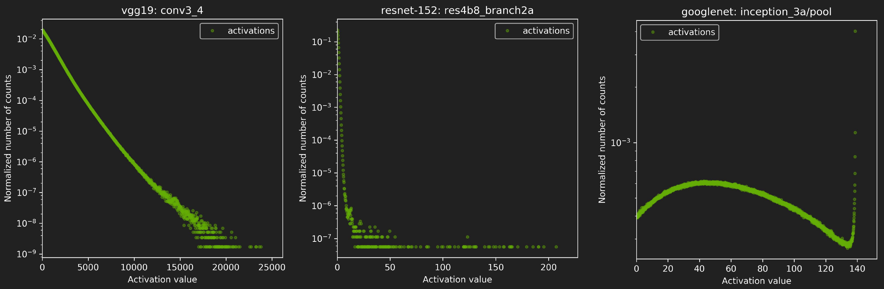
Quantization for int8 in NVIDIA TensorRT
[Migacz, 2017]
Examples of the distributions of activation

Slide 21
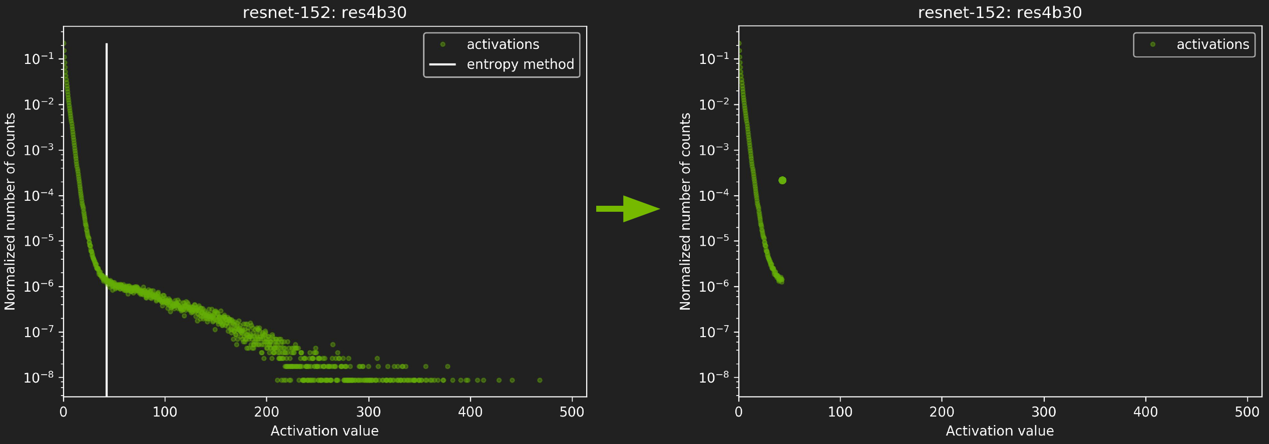
Quantization for int8 in NVIDIA TensorRT
[Migacz, 2017]
Basic idea of determining the threshold
Minimize information loss in the distribution of quantized data
KL divergence is used as the metric of information loss

Slide 22
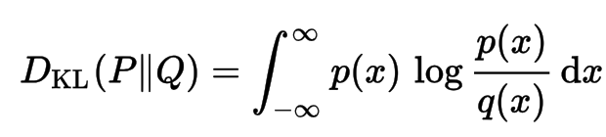
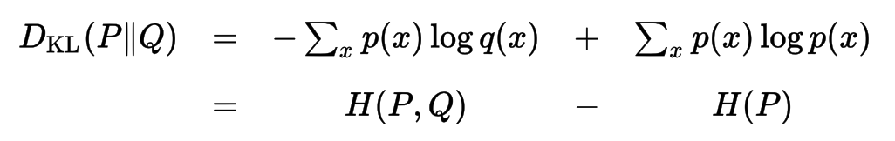
Kullback-Leibler (KL) Divergence
[https://en.wikipedia.org/wiki/Kullback–Leibler_divergence]
A measure of how one probability distribution diverges from a second expected probability distribution
The amount of information lost when Q is used to approximate P
The more similar distributions, the smaller KL divergence

Slide 23
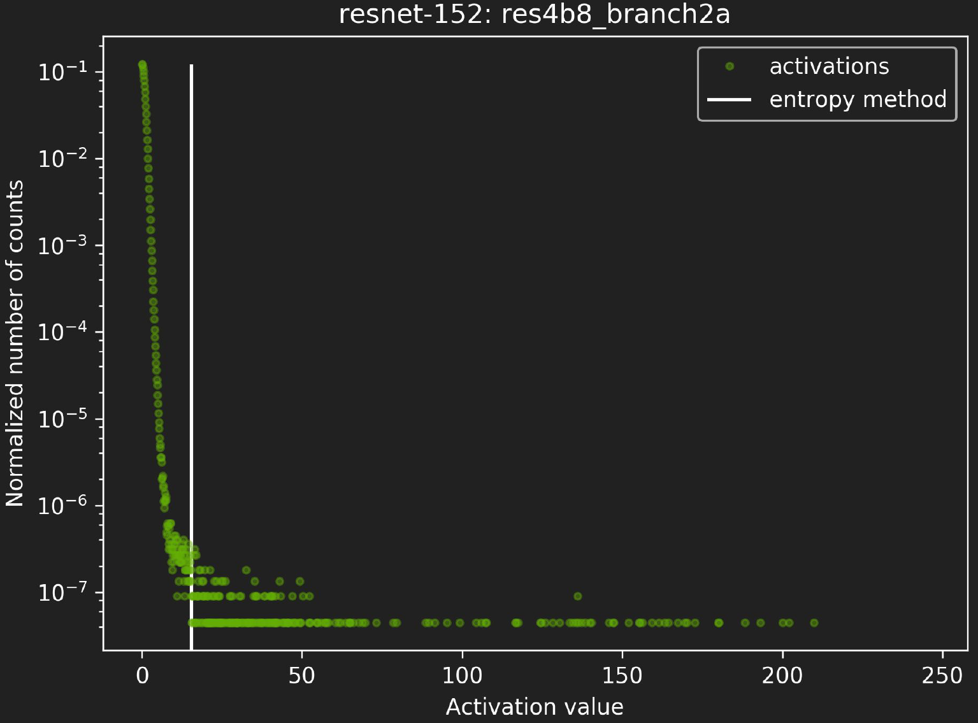
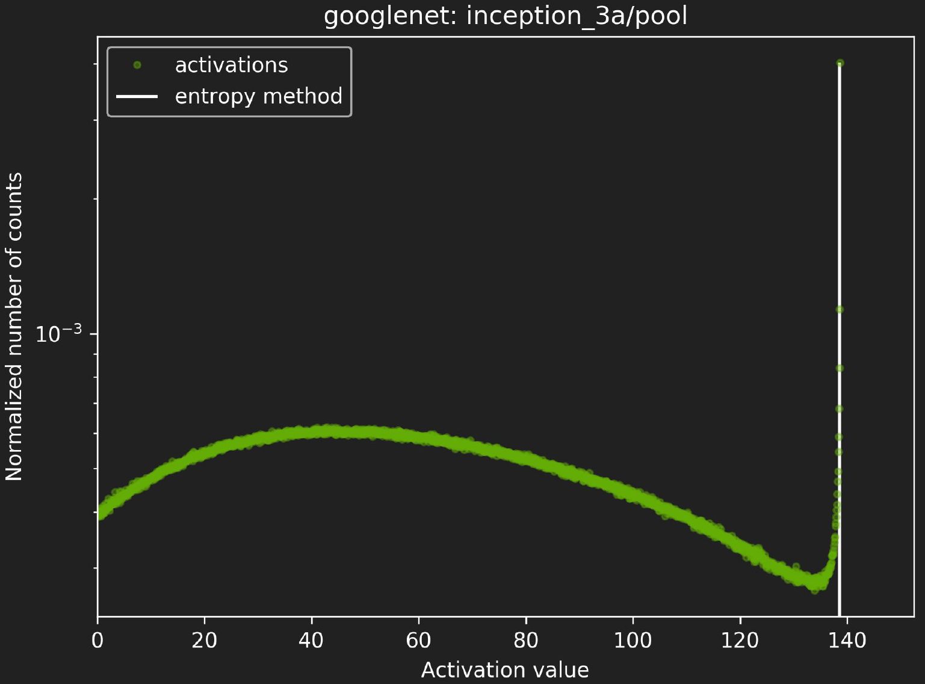
Quantization for int8 in NVIDIA TensorRT
[Migacz, 2017]
Quantization examples

Slide 24
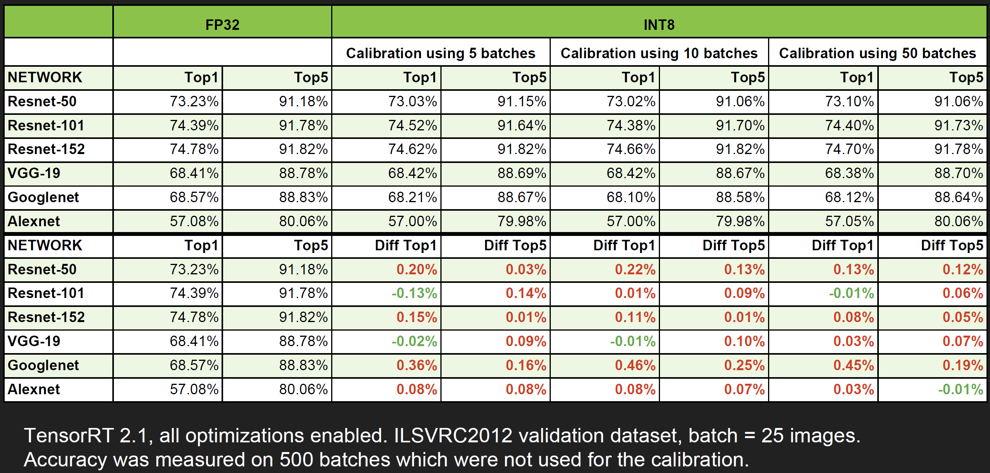
Quantization for int8 in NVIDIA TensorRT
[Migacz, 2017]

Slide 25
Quantization for Low Precision: Agenda
Google’s int8 quantization
Quantization and Training of Neural Networks for Efficient Integer-Arithmetic-Only Inference, CVPR 2018
NVIDIA’s int8 quantization
8-bit Inference with TensorRT
Logarithm-based quantization
Convolutional Neural Networks using Logarithmic Data Representation, CVPR 2017
Binary-weight neural network
XNOR-Net: ImageNet Classification Using Binary Convolutional Neural Networks

Slide 26
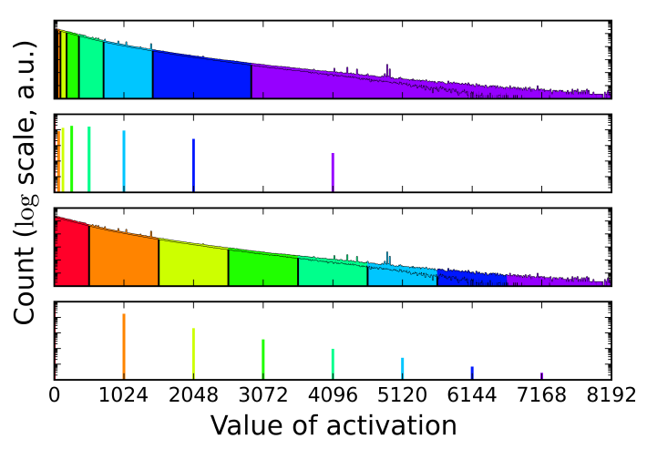
Logarithm-based Quantization (LogQuant)
[Miyashita, 2016]
Motivation
Less quantization errors for small values
No need of multiplication
b1101 x b0100 = shift(b1101, 2)
Multiplication becomes a shift operation

Slide 27
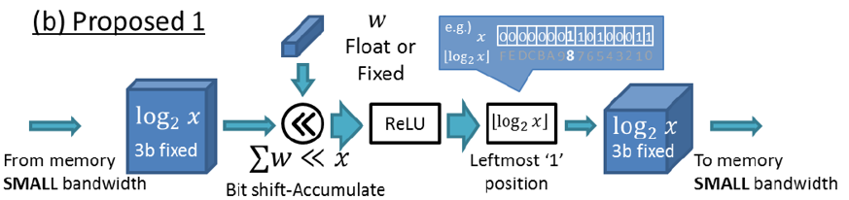
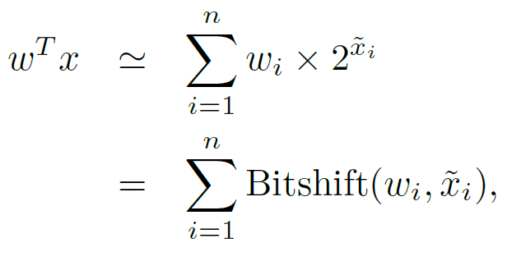
Logarithm-based Quantization (LogQuant)
5.5 * 4.5 = b101.1 * b100.1
~ b101.1 * b100.0 = Bitshift(b101.1, 2)
= b10110 (22 in decimal)
= b10000 (leftmost ‘1’)
24.75 ~ 5.5*4=22 (error = 2.75)
After activation quantization (truncation case)
22 → 16 (b10000)

Slide 28
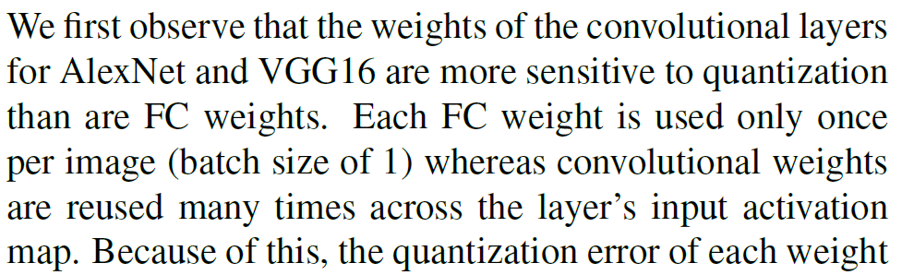
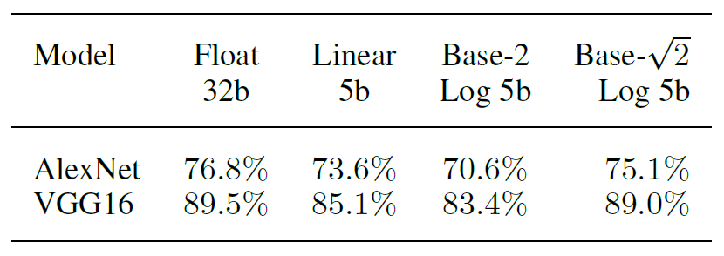
LogQuant for Weight (5b) and Activation (4b)
Activations are in 4b log
LogQuant applied to weights of convolutional layers
1.7% (AlexNet) and 0.5% (VGG) loss
Better than linear quantization
Conv weights are sensitive
Smaller base, 2^{1/2} or 2^{1/4} works well

Slide 29
Quantization for Low Precision: Agenda
Google’s int8 quantization
Quantization and Training of Neural Networks for Efficient Integer-Arithmetic-Only Inference, CVPR 2018
NVIDIA’s int8 quantization
8-bit Inference with TensorRT
Logarithm-based quantization
Convolutional Neural Networks using Logarithmic Data Representation, CVPR 2017
Binary-weight neural network
XNOR-Net: ImageNet Classification Using Binary Convolutional Neural Networks

Slide 30
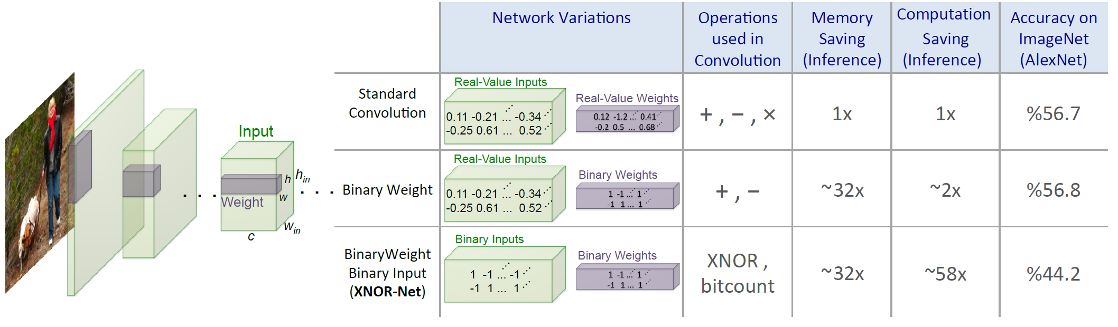
XNOR-Net
Two types of network
Binary-Weight network: only weights are binary, activations are 32-bit floating point values. It does not hurt accuracy while reducing weight size significantly
XNOR-Net: both weight and activation are binary

Slide 31
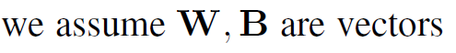
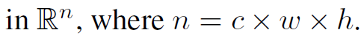
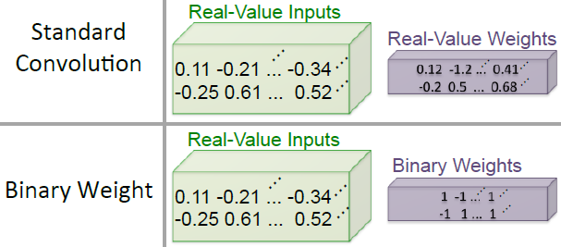
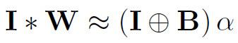
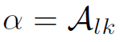
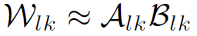
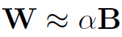
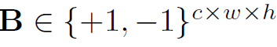
Binary-Weight-Network
W
B
x α
For k-th filter (output feature map) on l-th layer

Slide 32
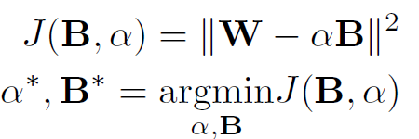
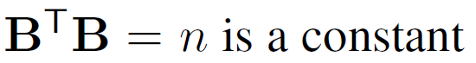
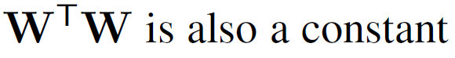
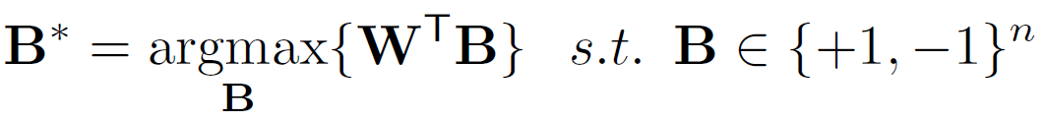
How to Obtain B and α ?
Solve this
c

Slide 33
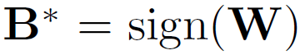
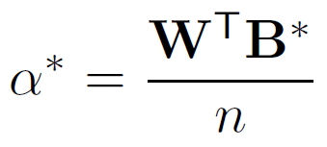
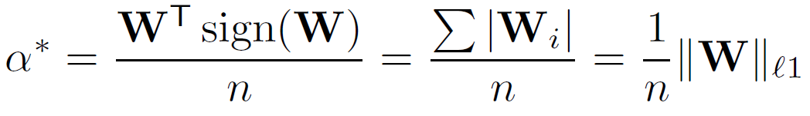
How to Obtain B and α ?
Solve this
*

Slide 34
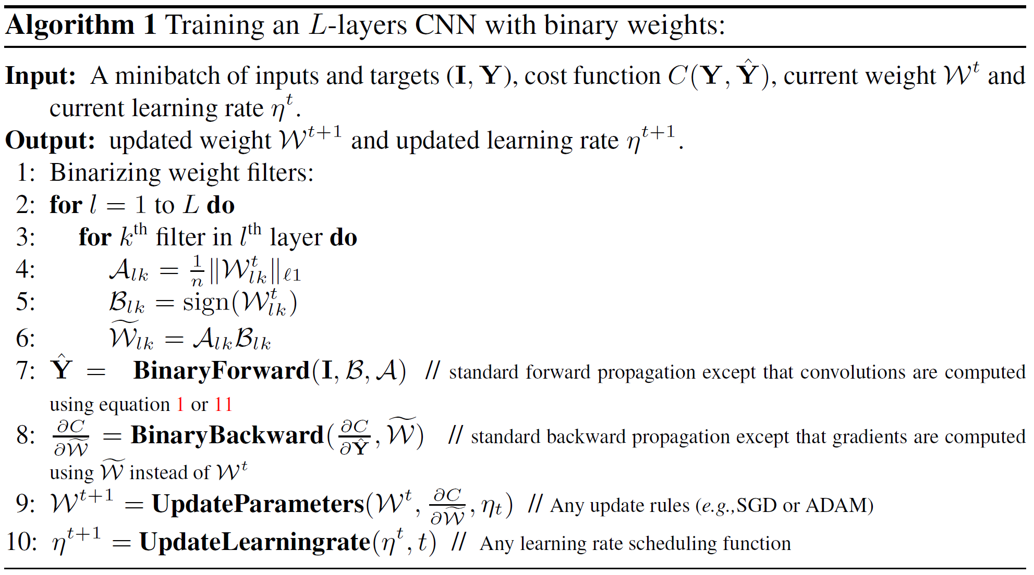
Training for Binary-Weight-Network
32bit
Forward pass with binary weights
Backward pass with binary weights
Update full-precision weights

Slide 35
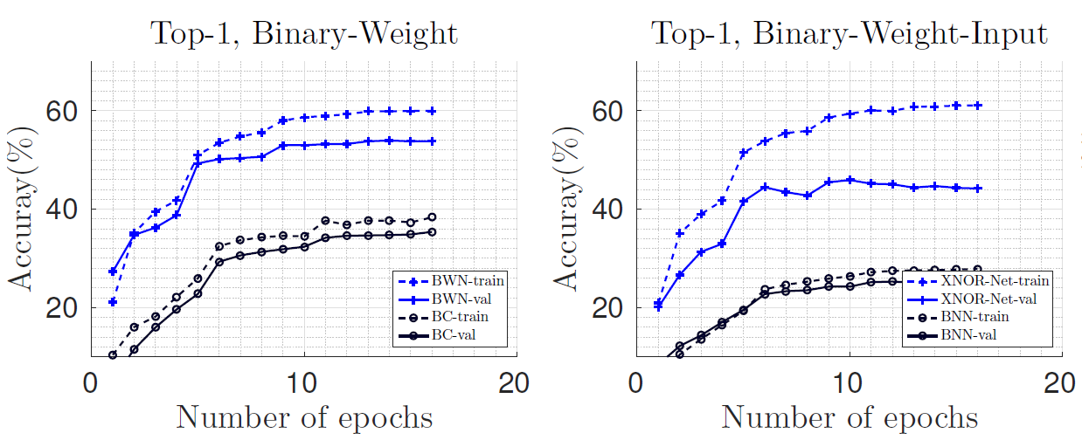
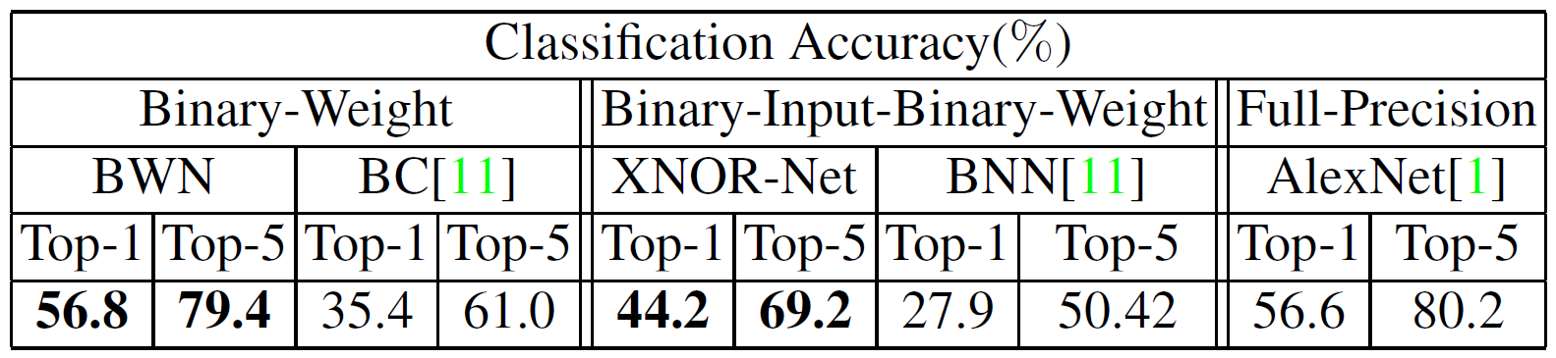
AlexNet Result
17% better than BinaryConnect (BC)

Slide 36
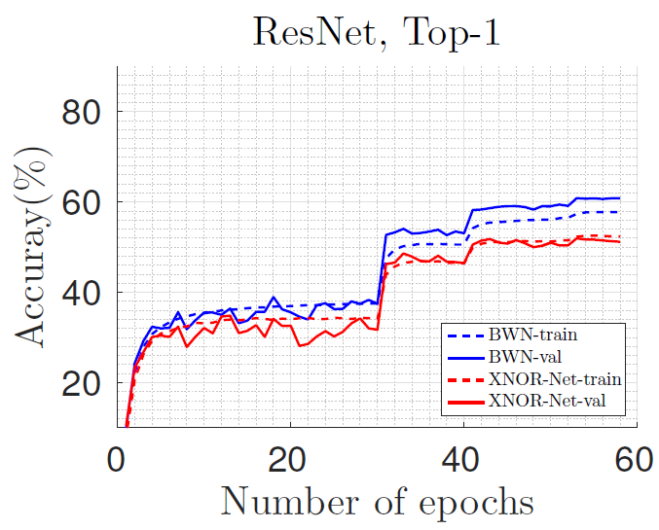
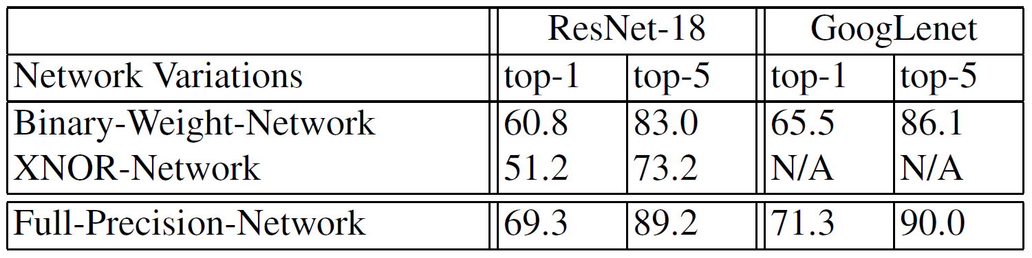
ResNet and GoogLeNet
Binary weight: 8.5% and 5.8% loss (top1)
XNOR: 18.1% loss in ResNet
Deeper models require more bits
How many bits are required for GoogLeNet to have less than 1% accuracy loss?
5~6 bits [Park, CVPR 2017]

Slide 37
MV Accelerator
Matrix M (N x N)
Input vector V
Result R
MV accelerator
TxT tile
Memory (BRAM)
w11
w12
v1
r1
w21
w22
v2
r1
r2
r2
C cycles
v1
v2
CPU
w11
w12
X
=
w21
w22
1
1
1
Buffer1
MAC1
Register
w11
w12
X
p1
w21
w22
X
p2
Buffer2
MAC2
Tile 1
Tile 2
Tile N/T
C cycles
T
T
Time
Total execution cycles of MV = ((N/T)*(C+T+T))*(N/T)

Slide 38
8-bit MV Accelerator Reduces Communication and Reduces Area w.r.t. 32-bit One
Matrix M (N x N)
Input vector V
Result R
MV accelerator
TxT tile
Memory (BRAM)
w11
w12
v1
r1
w21
w22
v2
r1
r2
r2
C’ cycles
v1
v2
CPU
w11
w12
X
=
w21
w22
1
1
1
Buffer1
MAC1
Register
w11
w12
X
p1
w21
w22
X
p2
Buffer2
MAC2
Tile 1
Tile 2
Tile N/T
C’ cycles
T
T
Time
Total execution cycles of MV = ((N/T)*(C+T+T))*(N/T)

Slide 39
Agenda
Lecture
Quantization for low precision computation on neural networks
Introduction to the lab on Week 11
MV accelerator for 8-bit quantization

Slide 40
Appendix

Slide 41
Fractional Exponent and Truncation in LogQuant
Base^{exponent}
10², 2³, 2^{1/2}, …
Fractional exponent (a.k.a radical or rational exponent) is often used in LogQuant
How to represent 2^{1/2}-base number?
2.5 in decimal (10-base) number = 2*10⁰ + 5*10⁻¹
2.5 in binary (2-base) number = 1*2¹ + 0*2⁰ + 1*2⁻¹ = 10.1
2.5 in 2^{1/2}-base number = 1*(2^{1/2})²+0*(2^{1/2})¹+0*(2^{1/2})⁰+0*(2^{-1/2})¹+1*(2^{-1/2})² = 100.01
How to perform quantization?
When truncation is adopted, only leading ‘1’ remains.
2.5 = 100.01 (base 2^{1/2}) → 100.00 (after quantization)

Slide 42
Binary-Weight-Network Example
W
Assume α=2,
I*W ~ I*Bx2 =
(0.11x1-0.21x(-1) … -0.34x1+
-0.25x(-1)+0.61x1+…0.52x1)x2
Only additions and subtractions!
B
x 2

